Slide 1
Chicago Heat Wave and the Social Autopsy
Unnatural Disasters
Seminar 6

Slide 2
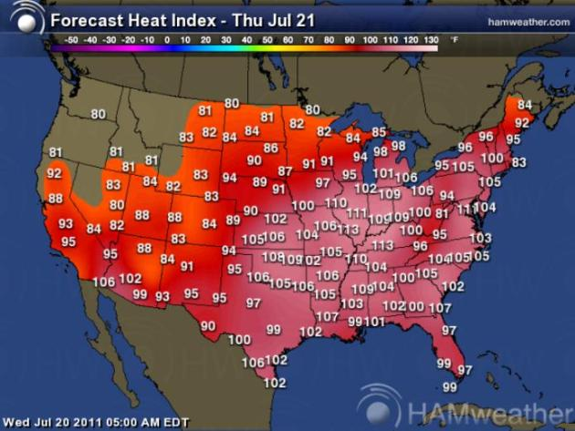
National Oceanic and Atmospheric Administration
"The principal cause of the July 1995 heat wave was a slow-moving, hot, and humid air mass produced by the chance occurrence at the same time of an unusually strong upper-level ridge of high pressure and unusually moist ground conditions." (10)

Slide 3
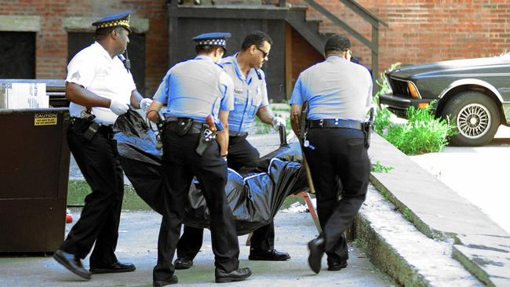
What accounts for what Eric Klinenberg calls the “human catastrophe”?

Slide 4
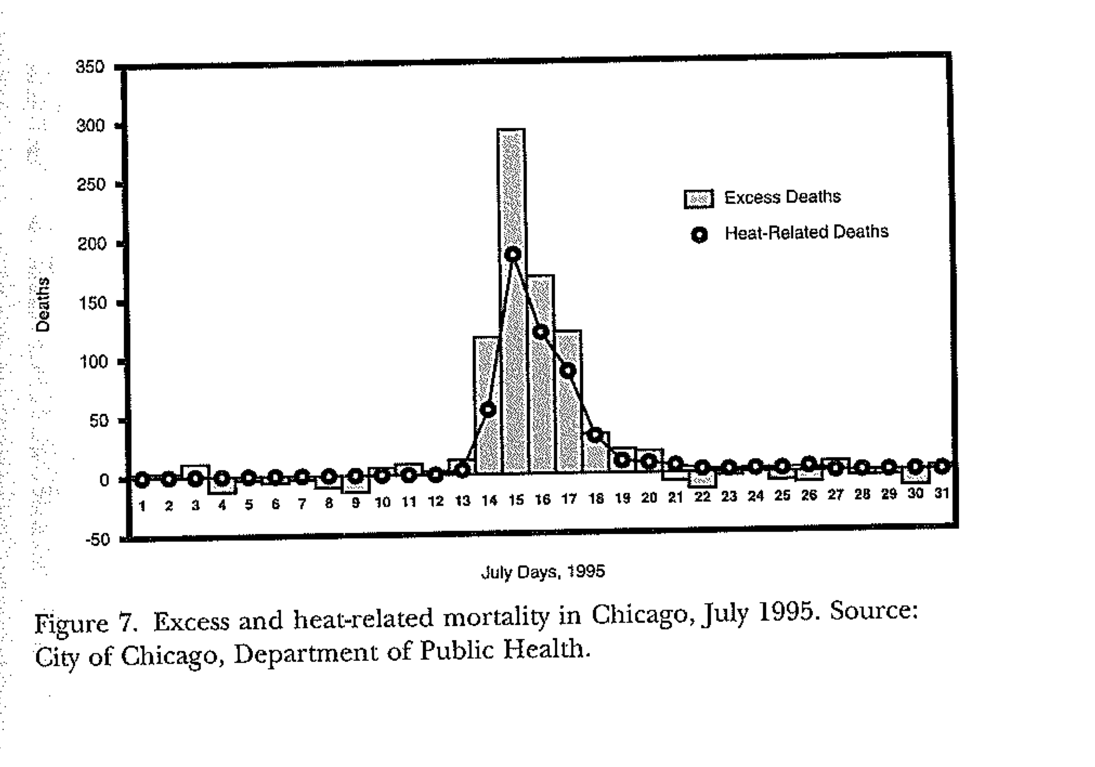
Sociological Tool 1: Excess death

Slide 5
Excess death
Allows researchers to identify:
An ‘event’, an epidemic:
‘relative risk’ and vulnerability

Slide 6
“biological reflections of social fault lines”
In group, identify one social fault line that contributed to relative excess mortality
Find evidence from text to support your point.

Slide 7
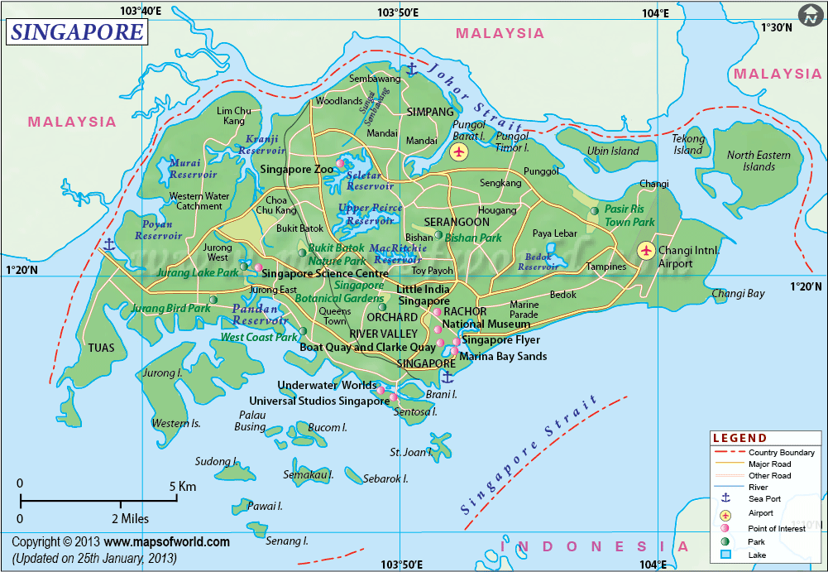
Singapore’s social fault lines
What boundaries between different groups make some more vulnerable than others to a heat-related injury or death?

Slide 8
What if we change our example to another kind of natural disaster?
Does [x] reveal different ‘social fault lines’?

Slide 9
Sociological Tool 2: Social Autopsy

Slide 10
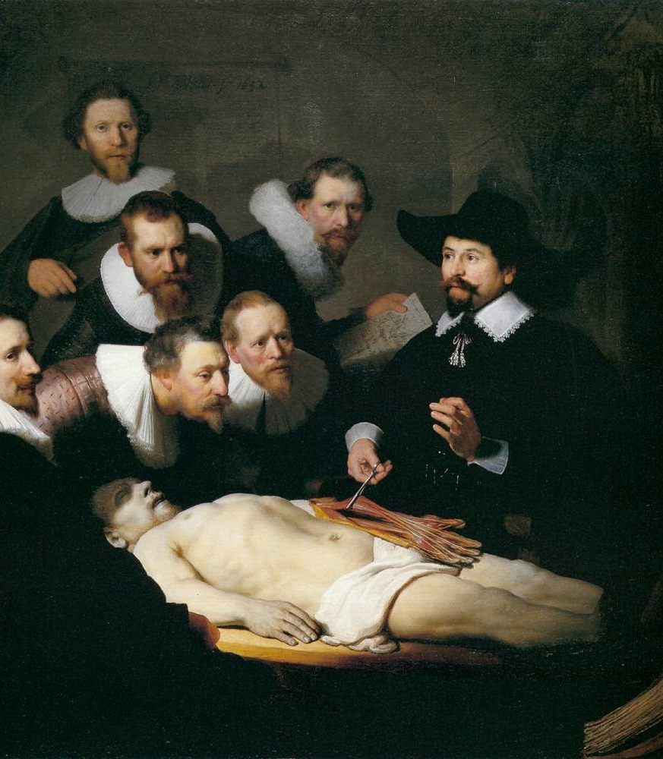
The Social Autopsy
Rembrandt,
Anatomy Lesson of Dr. Nicolaes Tulp (1632)

Slide 11
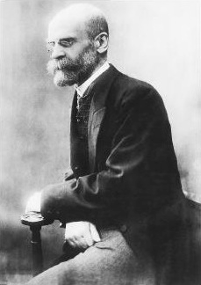
Emile Durkheim

Slide 12
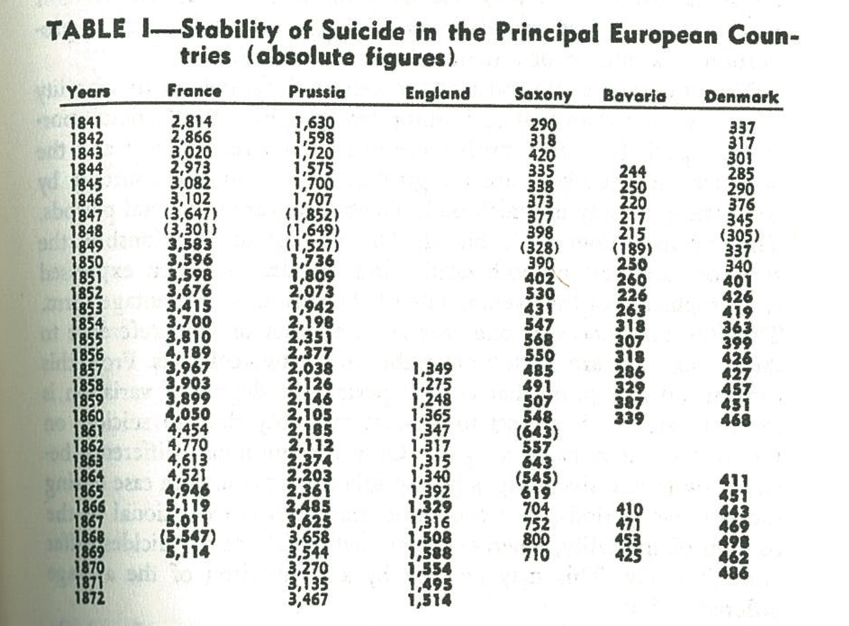
Suicide: the most private act?
From Emile Durkheim, Suicide

Slide 13

Relative risk

Slide 14
Pathology in society
"Just as the medical autopsy opens the body to determine the proximate physiological causes of mortality, this inquiry aims to examine the social organs of the city and identify the conditions that contributed to the deaths of so many Chicago residents that July.”
Klinenberg, Heat Wave:

Slide 15
Why should we study extreme events like natural disasters? Aren’t they atypical or abnormal, and therefore we should ignore them?

Slide 16
What methods can be used in a social autopsy?

Slide 17
Modern blame
Would Kant or Rousseau agree with the ‘social autopsy’? Why or why not?

Slide 18
Dying Alone
The story of Pauline Jankowitz
Read the story: pp. 50-54
What aspects of her isolation are socially produced?
What aspects of her isolation are materially or technologically produced?

Slide 19
Dying Alone
Why do people live alone?

Slide 20
Why does living alone put you at greater risk of death during heat wave?

Slide 21
Alone in society
How is living alone “socially produced”?

